Slide 1
İleri Java Programlama
Emir Öztürk
MySQL, Spring, REST ve BenzerBul Uygulaması

Slide 2
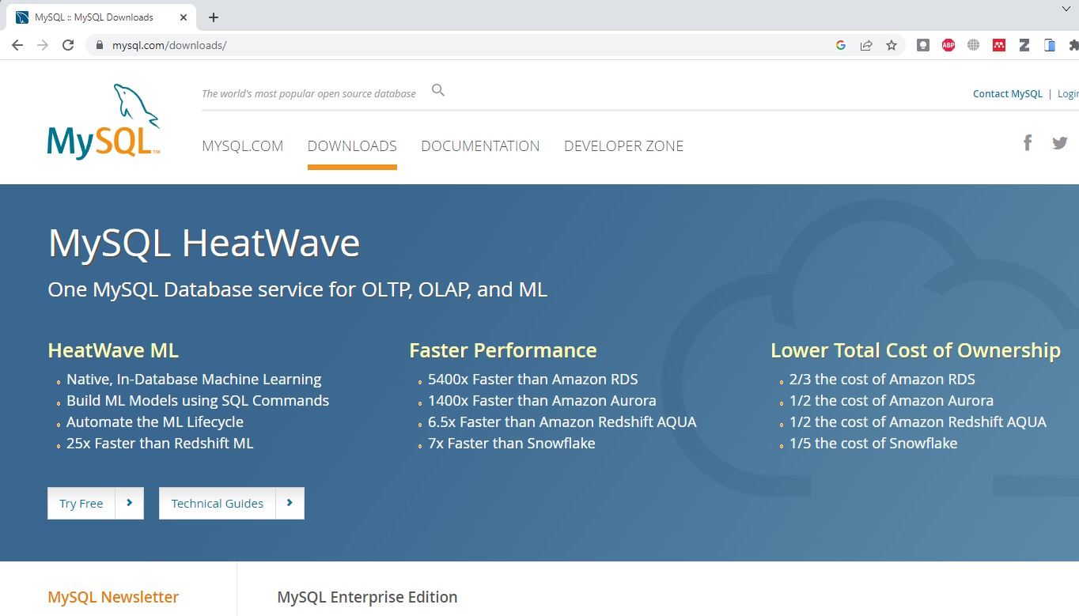
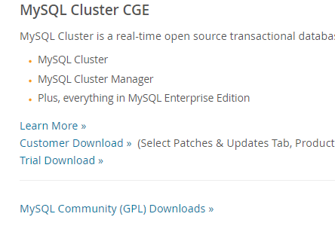
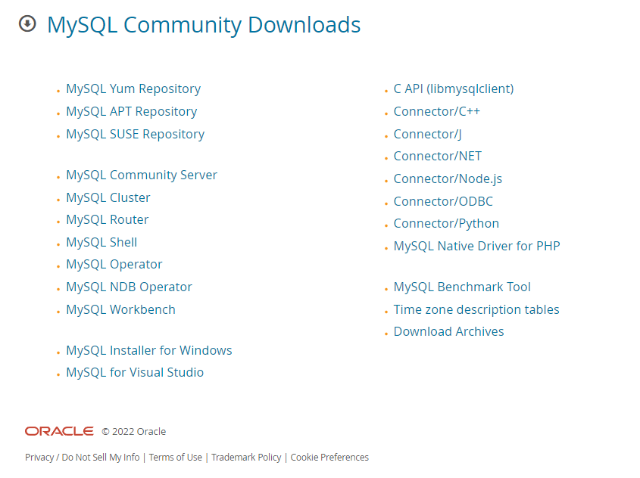

Slide 3
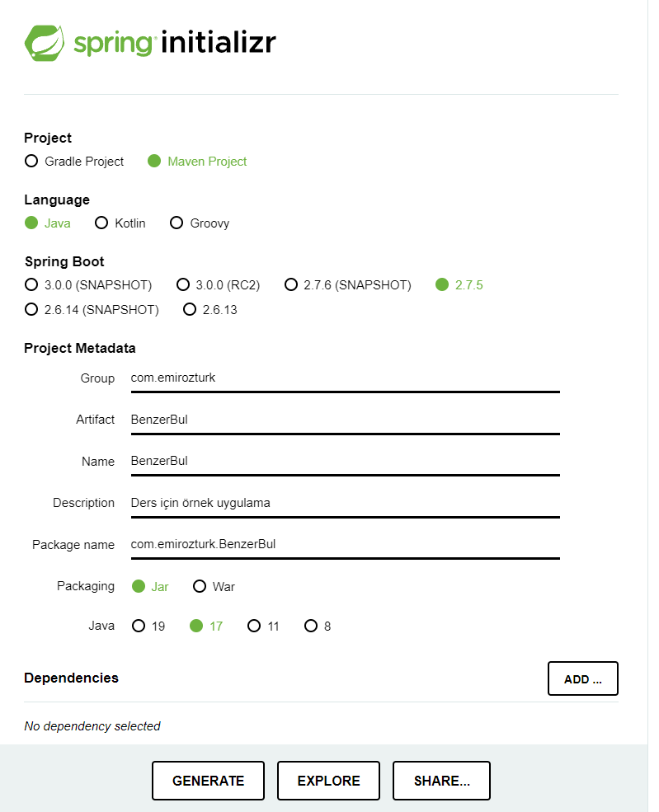
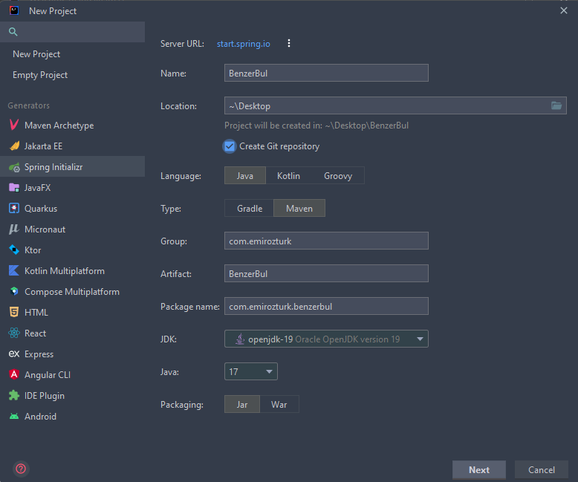

Slide 4
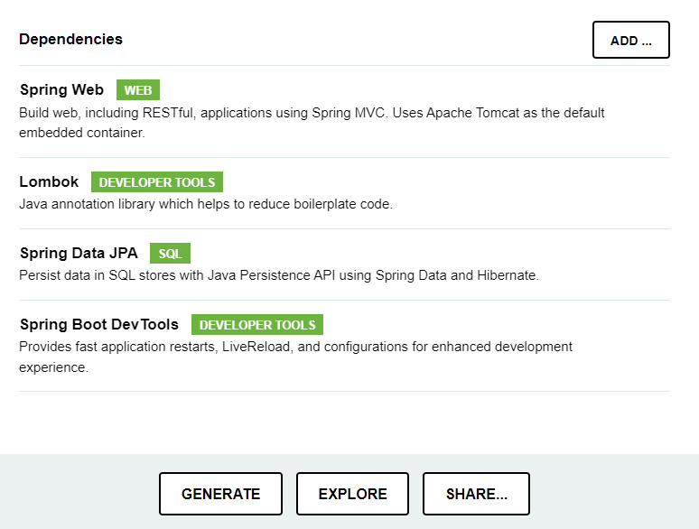
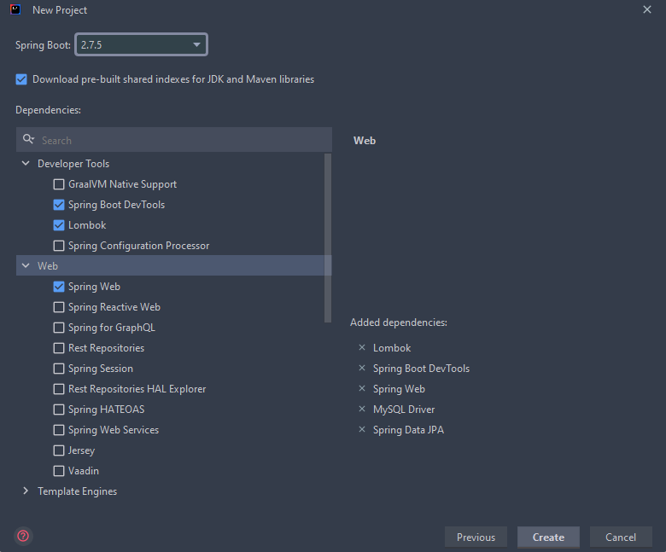

Slide 5
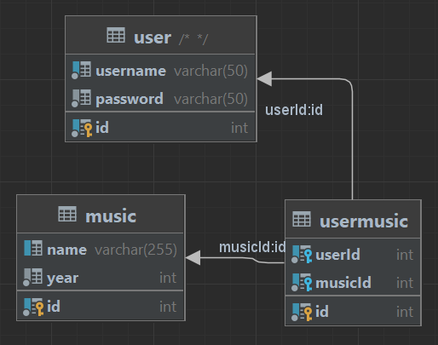

Slide 6
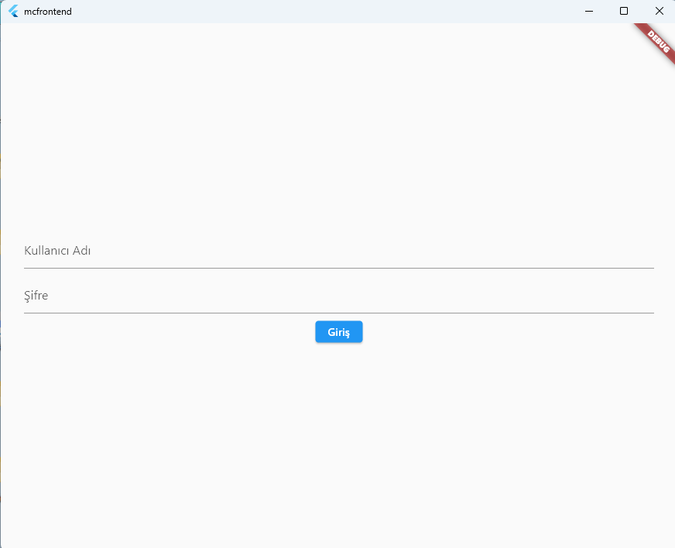
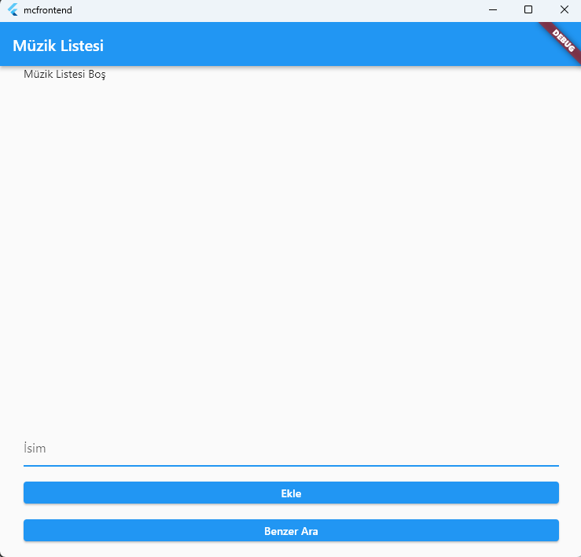
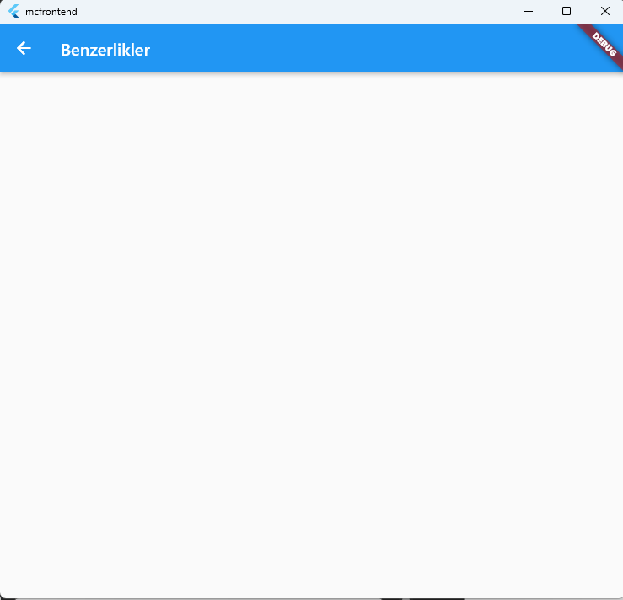

Slide 7
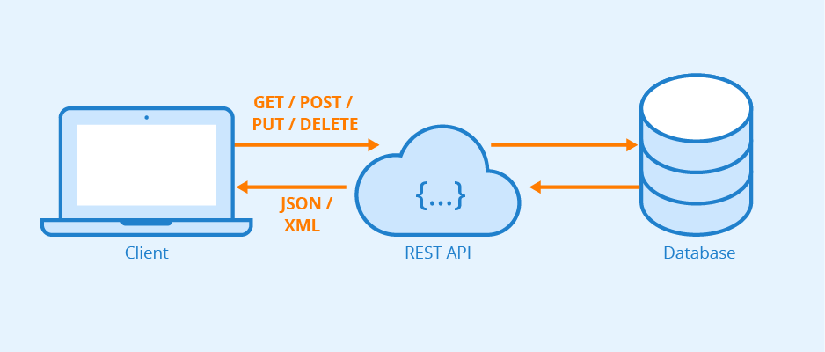
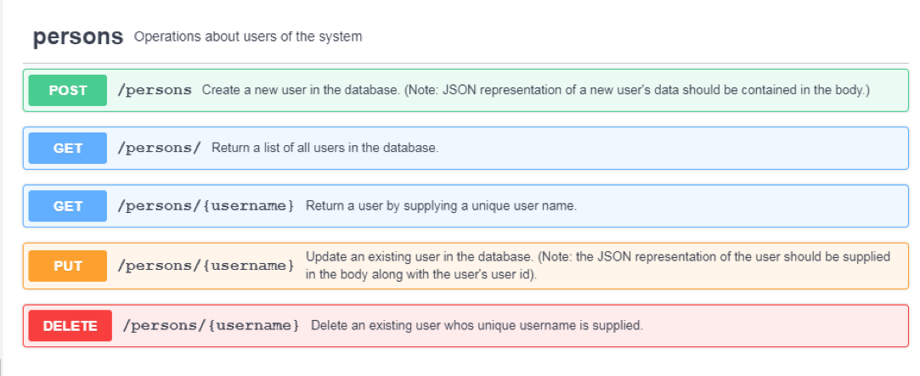

Slide 8
Metot | Http Metodu | Path
login | POST | /Login/
addUser | POST | /user
removeUser | DELETE | /user/{username}
getUsers | GET | /user/{username}
updateUser | PUT | /user/{username}
addMusic | POST | /music
deleteMusic | DELETE | /music/{id}
GetSimilar | GET | /similarto/{username}

Slide 9
Entity
(Model)
Music
Music
Music
User
User
User
Database
Client
User
Similarity
Similarity
Similarity
REST
Service
DAL (!DAO)

